Slide 1
Unit 4 The Hierarchical Model
4.1 The Hierarchical Model
4.2 IMS

Slide 2
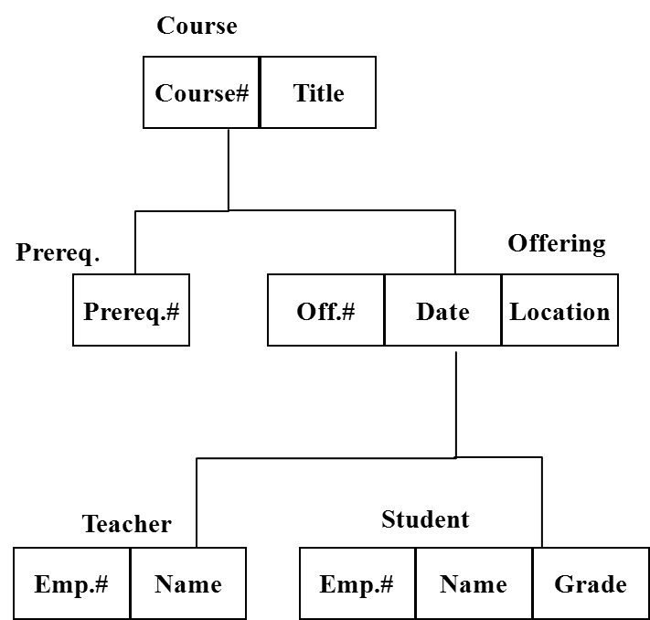
Hierarchical Database Model
A hierarchical database model is a data model in which the data is organized into a tree-like structure.
Example of a hierarchical model
Source: From Wikipedia, the free encyclopedia

Slide 3
The First Database Model
The structure allows representing information using parent/child relationships: each parent can have many children, but each child has only one parent (also known as a 1-to-many relationship).
This model is recognized as the first database model created by IBM in the 1960s.
Currently the most widely used hierarchical databases are IMS developed by IBM and Windows Registry by Microsoft.
Source: From Wikipedia, the free encyclopedia

Slide 4
4.1 The Hierarchical Model
format
(1) Data Structure
An ordered set of trees, more precisely,
an ordered set consisting of multiple
occurrences of a single type of tree.
S
S# SNAME STATUS CITY
S1 Smith 20 London
S2 Jones 10 Paris
S3 Blake 30 Paris
S4 Clark 20 London
S5 Adams 30 Athens
(records)
1
1
2
3
4
5
1. format
2. occurrences
(records) data
pointer
1
2
3

Slide 5
The Hierarchical Model: Segment
e.g. Tree type of an education database
“pile”
Course
course# name prereq.1 prereq.2 off.1 85/2/6 EE T003 Yang
108
Course#
Title
course#, name prereq off. 1 off. 2
Prereq.
Offering
Prereq.#
Off.#
Date
Location
85/2/6
...
prereq.1 prereq.2
...
1. Five record (segment) types:
Course, Prereq, Offering, Teacher, student.
2. Difference with relational model:
(i) parent:child vs. foreign key
(ii) operators
Teacher
Student
Emp.#
Name
Emp.#
Name
Grade

Slide 6
The Hierarchical Model: Occurrence
Occurrence
M23 DBMS M16 M19 1 85/9/1 EC210 T003 Yang 7617503 ... 2
Course
M95
N.N.
M23
DBMS
Fig. 4.2: Hierarchical Sequence
Offering
M19
3
M16
2
1
85/9/1
EC210
Teacher
Student
T003
Yang
3
7617503
G.Hwang
5

Slide 7
The Hierarchical Model: Data Manipulation
(2) Hierarchical Data Manipulation
A set of operators for processing data represented in the form of trees
[3] Now, where is the first child?
Course
[1] Locating to a specific segment.
M23
DBMS
Offering
M19
M16
1
85/9/1
EC210
Teacher
Student
[2] Now, where is the next?
T003
Yang
7617503
G.Hwang
3

Slide 8
The Hierarchical Model: Data Integrity
(3) Hierarchical Data Integrity
Rule: no child is allowed to exist without
its parent, i.e., a kind of referential integrity.

Slide 9
4.2 IMS
Overview
IMS (Information Management System)
An IBM product
One of the first DBMS to be commercially
Available in 1968

Slide 10
IMS: Data Definition
(1) Data Definition e.g. Educational Database (p.4-3)
1 DBD NAME=EDUCPDBD, ACCESS=HSAM
v 2 SEGM NAME=COURSE, BYTES=36
3 FIELD NAME=(COURSE#, SEQ), BYTES=3, START=1
4 FIELD NAME=TITLE, BYTES=33, START=4
v 5 SEGM NAME=PREREQ, PARENT=COURSE, BYTES=3
6 FIELD NAME=(PREREQ#, SEQ), BYTES=3, START=1
v 7 SEGM NAME=OFFERING, PARENT=COURSE, BYTES=21
8 FIELD NAME=(OFF#, SEQ), BYTES=3, START=1
9 FIELD NAME=DATE, BYTES=6, START=4
10 FIELD NAME=LOCATION, BYTES=12, START=10
v11 SEGM NAME=TEACHER, PARENT=OFFERING, BYTES=24
12 FIELD NAME=(EMP#, SEQ), BYTES=6, START=1
13 FIELD NAME=NAME, BYTES=18, START=7
v14 SEGM NAME=STUDENT, PARENT=OFFERING, BYTES=25
15 FIELD NAME=(EMP#, SEQ), BYTES=6, START=1
16 FIELD NAME=NAME, BYTES=18, START=7
17 FIELD NAME=CRADE, BYTES=1, START=25

Slide 11
IMS: Data Manipulation
(2) Data Manipulation
Application program EDPCB
A PL/I program STUDENTAREA
.
. PL/I CSSA
. OSSA
SSSA
Call PLITDLI(SIX,GU, EDPCB
STUDENTAREA, CSSA,
OSSA, SSSA)
.
. PL/I
.
Working Area
begin
PL/I + DL/I
DL/I
PL/I to DL/I --> into IMS
end

Slide 12
Call PLITDLI(SIX,GU, EDPCB, STUDENTAREA, CSSA, OSSA, SSSA)
Working Area
SIX: six arguments will be used
GU: get unique, and operator
EDPCB (Communication Block):
a cursor and a feedback area
(SQLCA in DB2) (ref. p.2-41)
STUDENTAREA: I/O area, a buffer
SSA: Segment Search Arguments
CSSA: Course, OSSA: Offering, and SSSA: Student
e.g.
CSSA: Course where TITLE='DBMS'
OSSA: Offering where DATE='85/9/1'
SSSA: Student where GRADE=‘3'
EDPCB
STUDENTAREA
CSSA
OSSA
SSSA
condition

Slide 13
The Hierarchical Model: Occurrence
Occurrence
M95
N.N.
Course
M23
DBMS
Offering
M19
3
M16
2
1
85/9/1
EC210
e.g.
CSSA: Course where TITLE='DBMS'
OSSA: Offering where DATE='85/9/1'
SSSA: Student where GRADE=‘3'
Teacher
Student
T003
Yang
7617503
G.Hwang
5
3

Slide 14
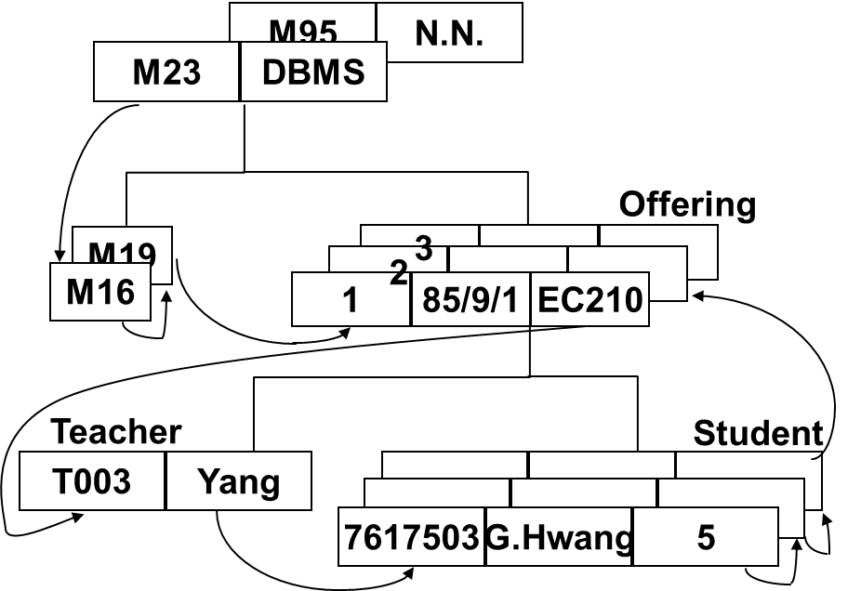
IMS: Data Manipulation operation
IMS operations:
GET Unique (GU ): Direct Retrieval
GET Next (GN ): Sequential Retrieval
GET Next within Parent (GNP):
Sequential Retrieval under current parent
GET Hold (GHU, GHN, GHNP):
as above but 'LOCK'
Insert (ISRT): Add new segment
Delete (DLET): Delete existing segment
Replace (REPL): Replace existing segment
……

